Slide 1
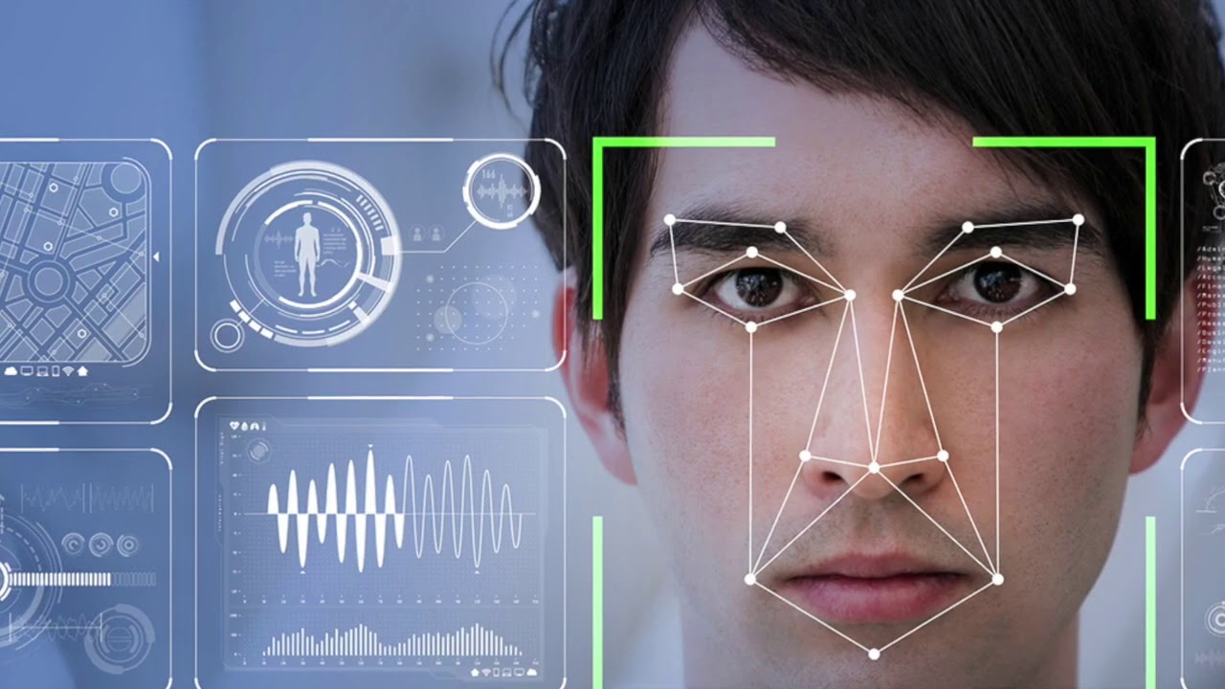

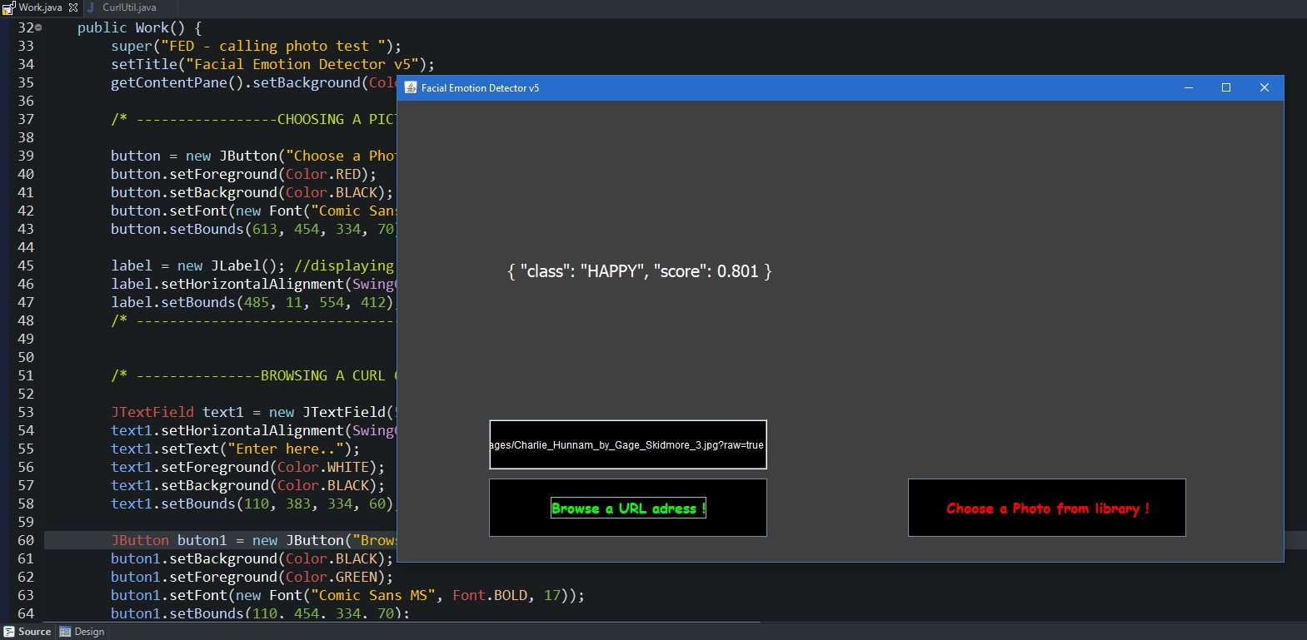
Engineering Project – Prototype II Facial Emotion Detector v5
MERT ALTUNTAŞ - 1804010005

Slide 2
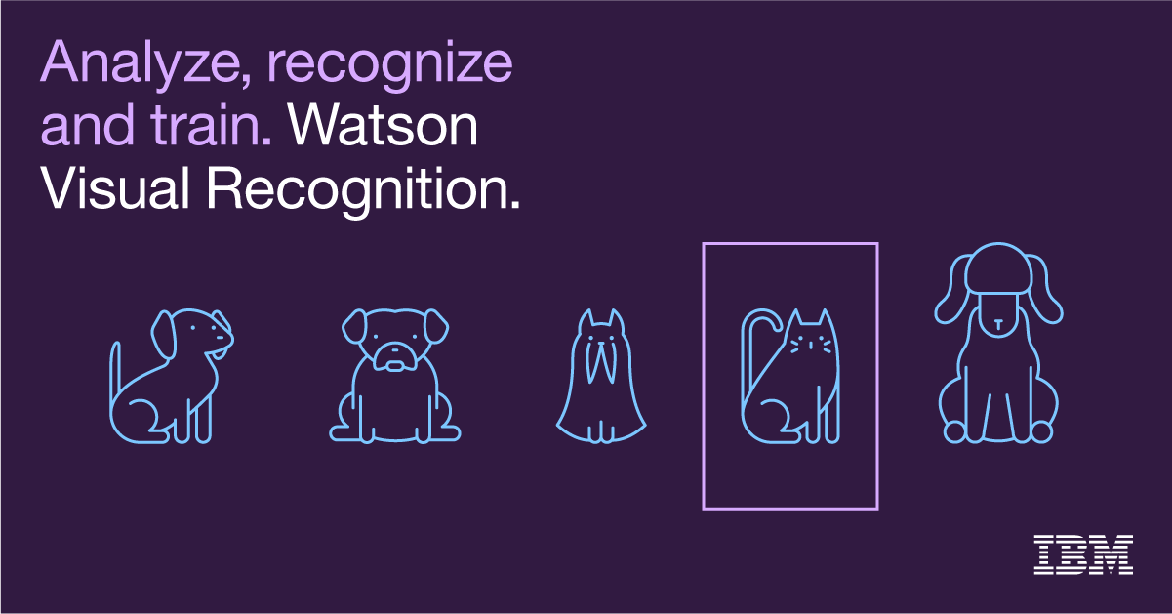

About Project
This Project aims detecting facial emotions of people and in additional, recognizing other objects except people.
In general this Project based on Convolutional Neural Networks.

Slide 3
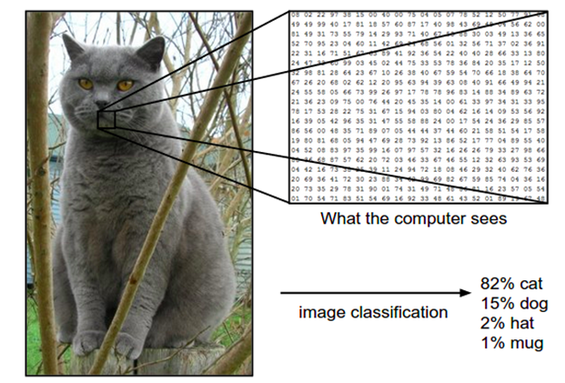
Convolutional Neural Networks
Recognizing a picture automatically
Transforming pixels into a matrix.
These process powered by IBM Watson.

Slide 4

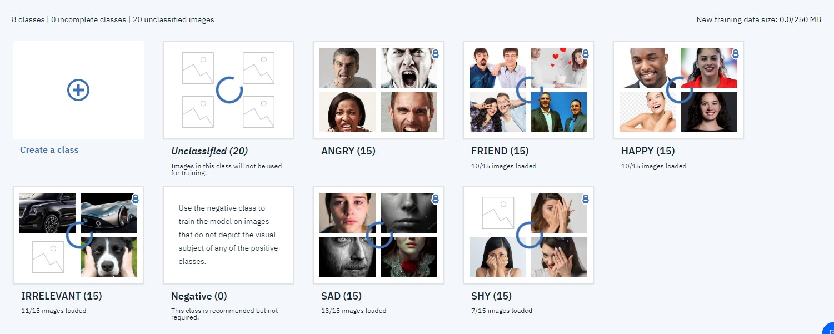
Project Steps
Collecting pictures from the Internet (about 240 photos)
Creating an IBM Watson account.
Feeding IBM Watson with the data.

Slide 5
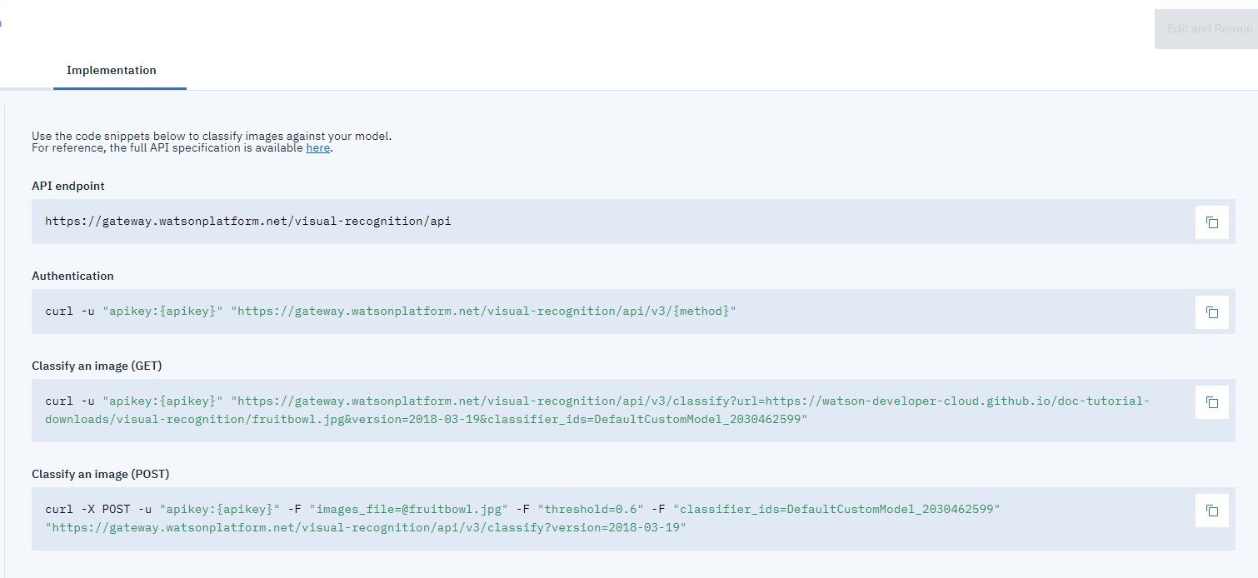
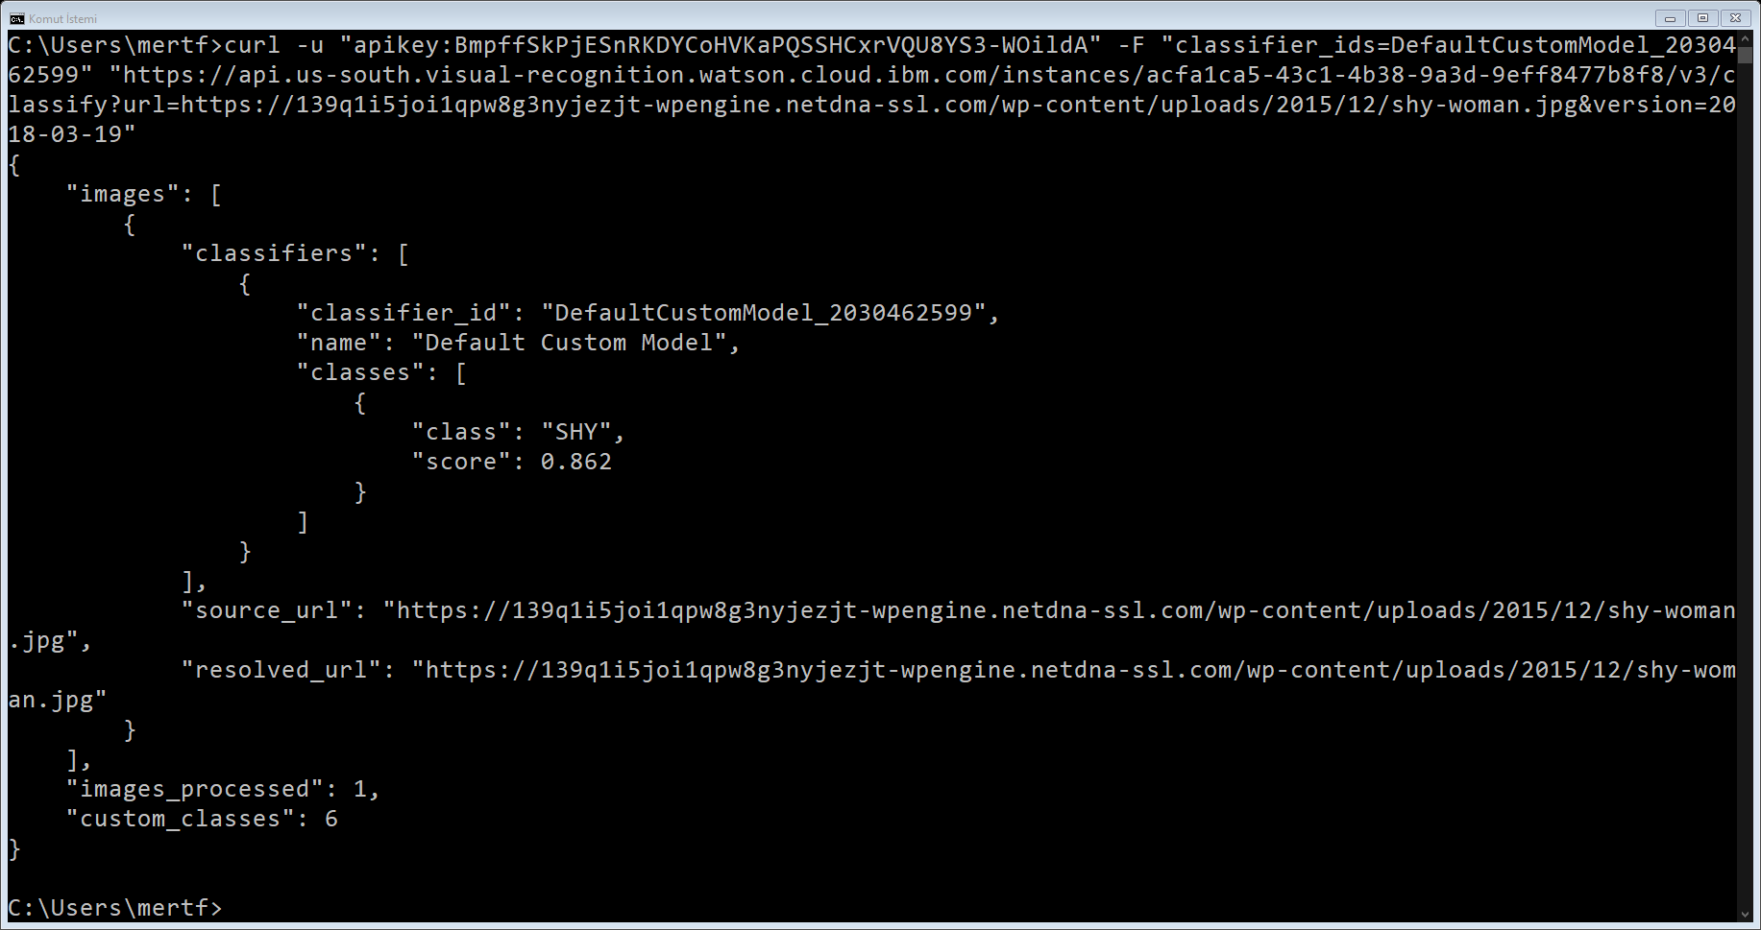
Learning cURL commands and their usage.
Calling the system with cURL commands in Windows.

Slide 6
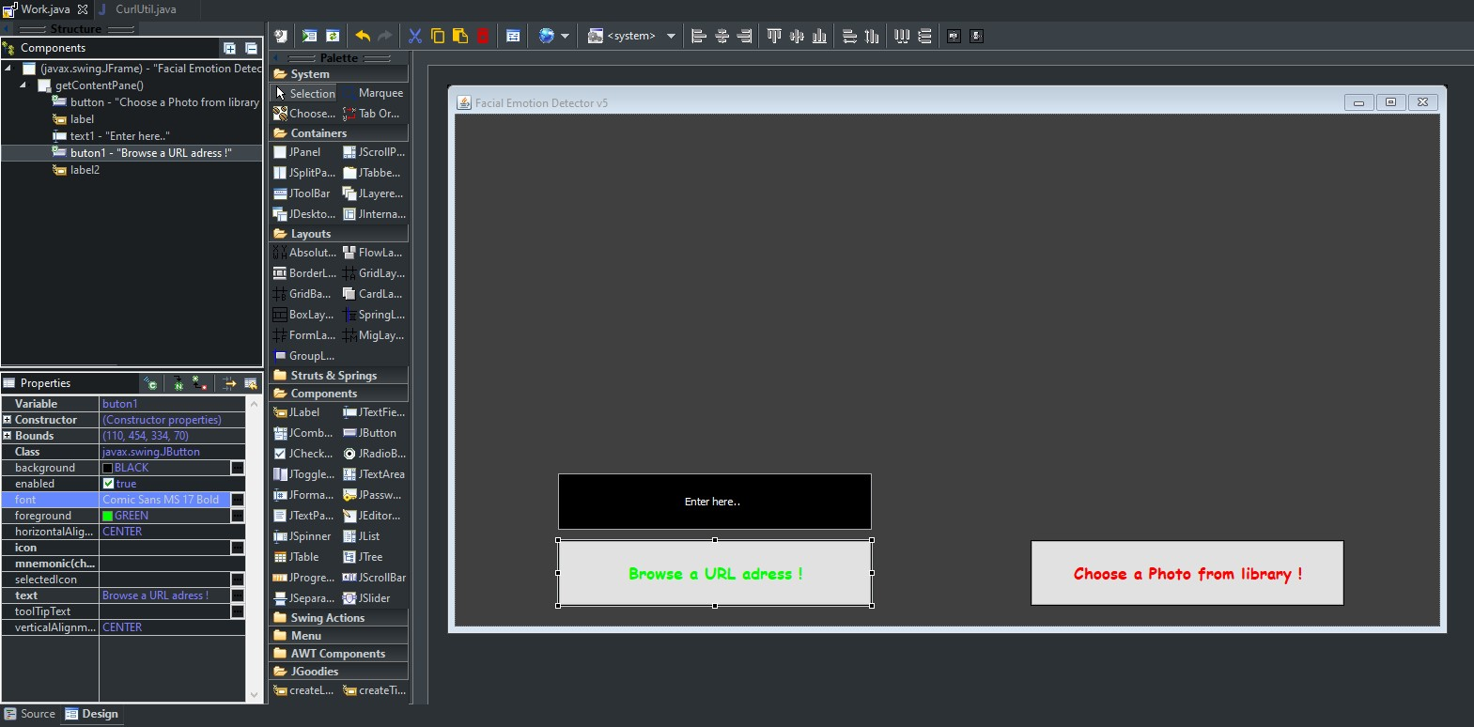
Developing User Interface in Java (Eclipse IDE)

Slide 7
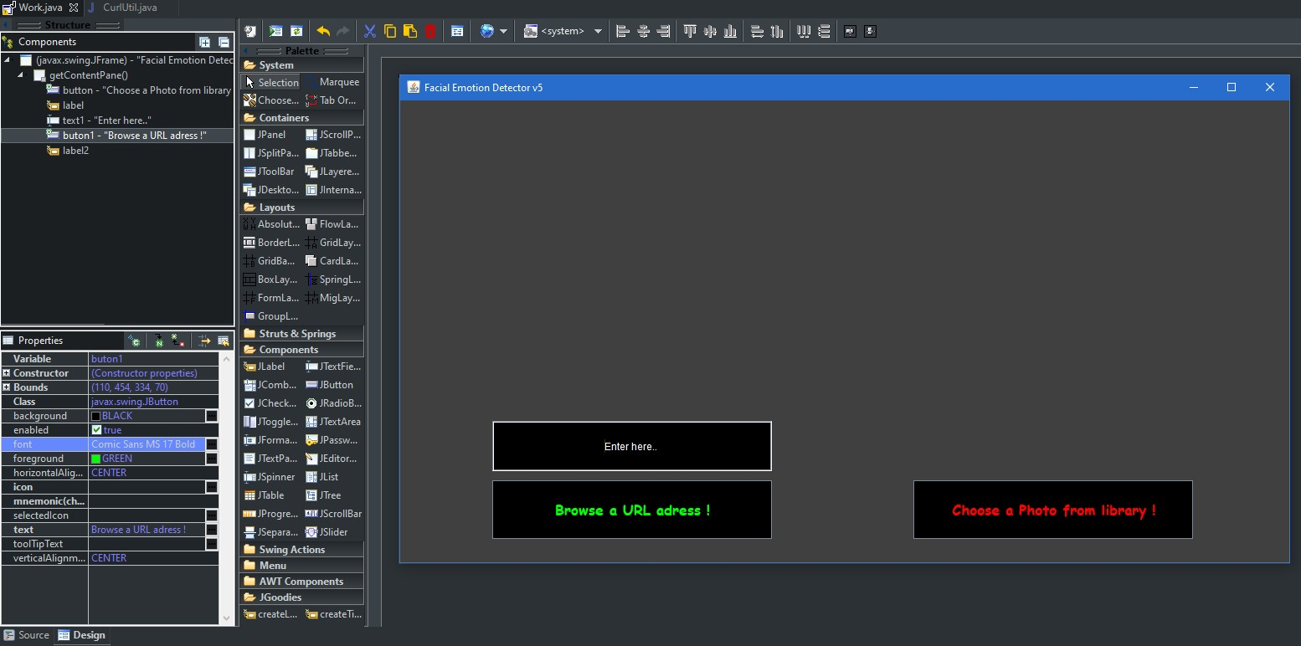
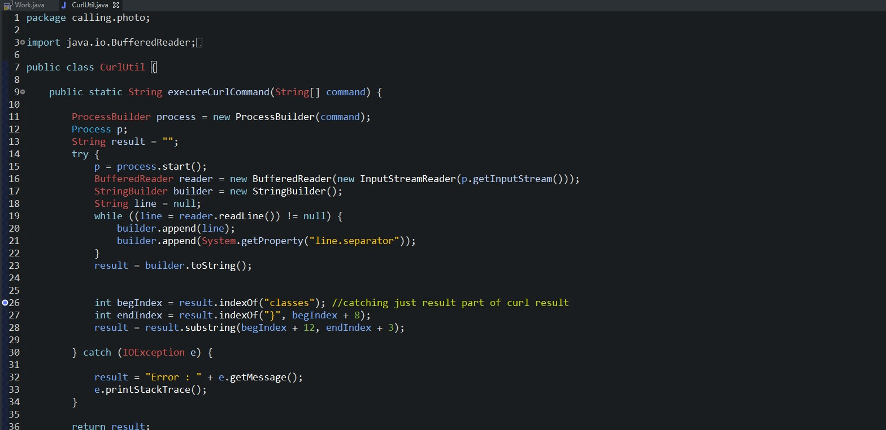
How it Works ?
The user interface is responsible for all process.
The URL adress converting into cURL command.
The result is displaying on screen.

